Slide 1
SIWES PRESENTATION
Kayode Peter Temitope
208077
Computer Science, 200 Level

Slide 2

ITNH (Information Technology Network and Hardware Infrastructure) is a section under the general information and media section of the University (ITeMS), responsible for the planning, analysis, design, implementation and operation of computer networking facilities and infrastructures around the University of Ibadan environs.

Slide 3
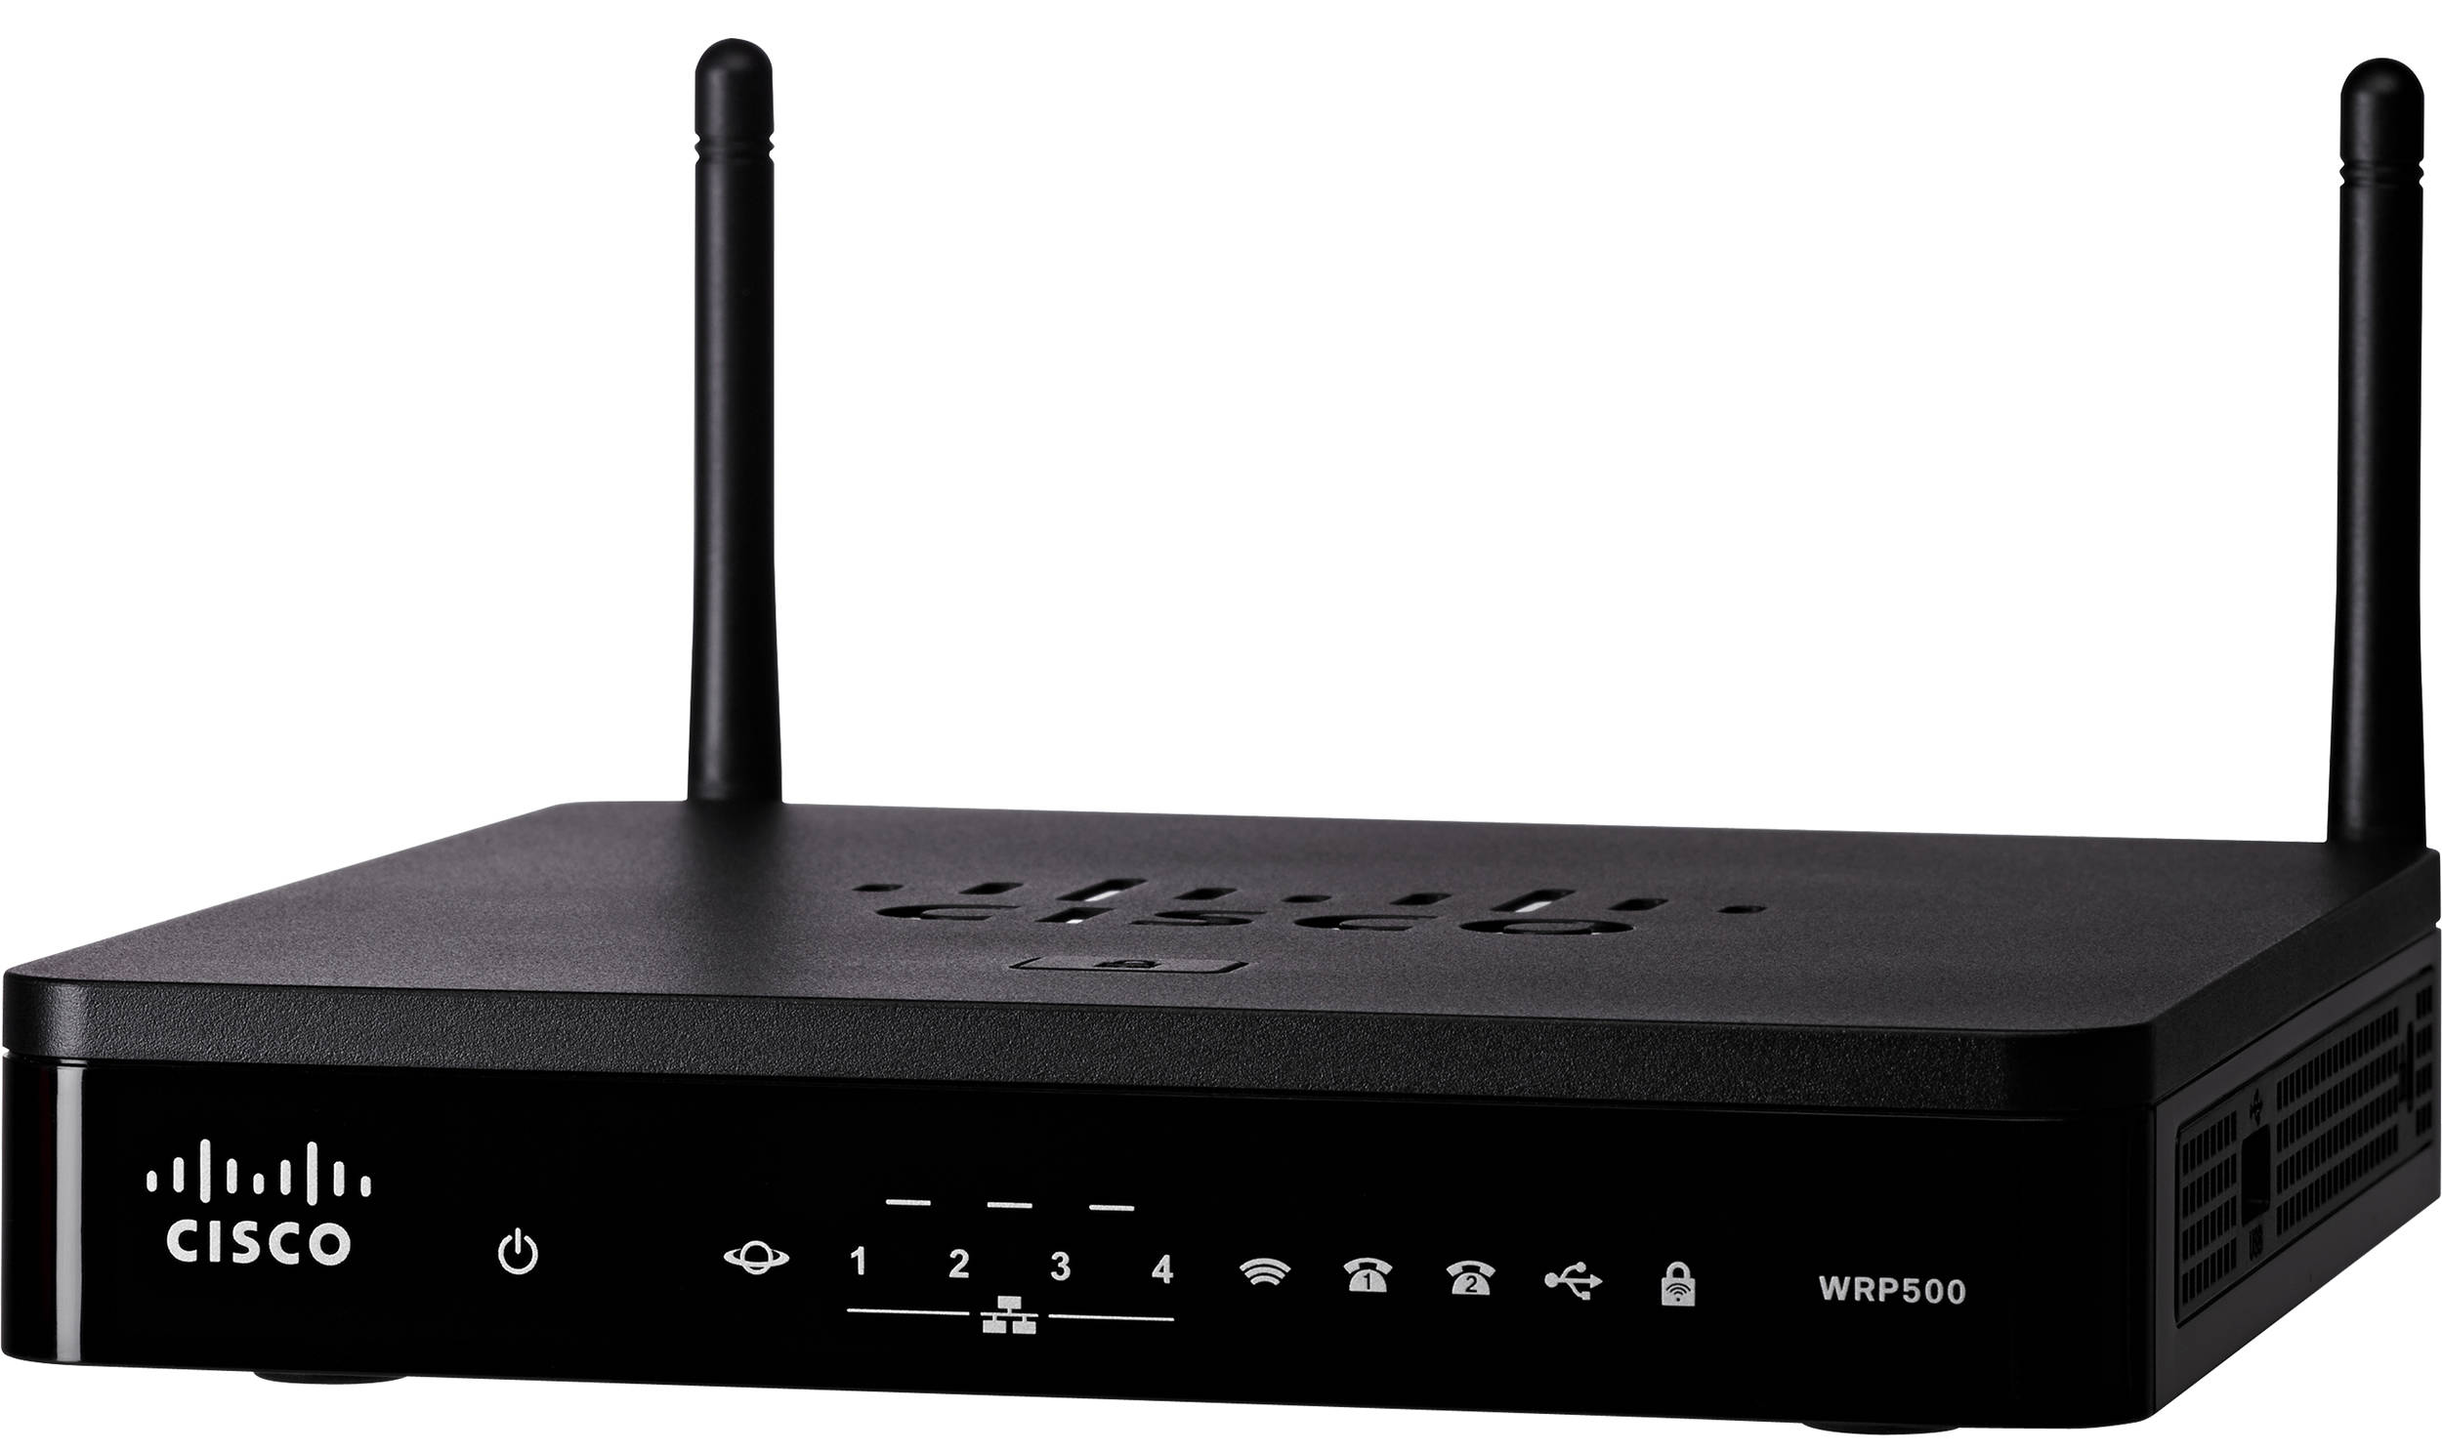
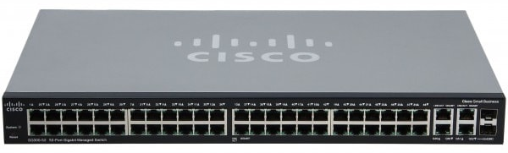
Major devices used at ITNH
A switch is a networking device operating at layer 2 or a data link layer of the OSI model. They connect devices in a network and use packet switching to send, receive or forward data packets or data frames over the network. A switch has many ports, to which computers are plugged in. When a data frame arrives at any port of a network switch, it examines the destination address, performs necessary checks and sends the frame to the corresponding device(s).It supports unicast, multicast as well as broadcast communications.
A router is a device that connects two or more packet-switched networks or subnetworks. It serves two primary functions: managing traffic between these networks by forwarding data packets to their intended IP addresses, and allowing multiple devices to use the same Internet connection.

Slide 4
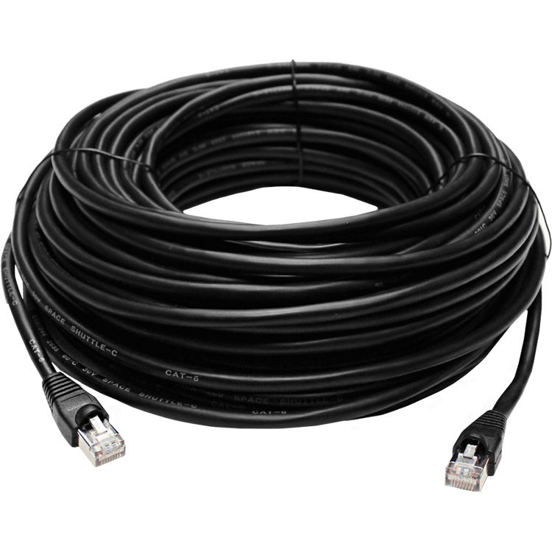
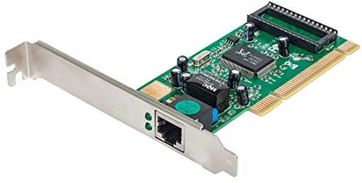
Major devices used at ITNH
A Network interface card (also known as a NIC, network card, or network interface controller) is an electronic device that connects a computer to a computer network , usually a LAN. It is considered a piece of computer hardware. Most modern computers support an internal network interface controller embedded in the motherboard directly rather than provided as an external component.
Networking cables are networking hardware used to connect one network device to other network devices or to connect two or more computers to share devices such as printers or scanners. Different types of network cables, such as coaxial cable, optical fiber cable, and twisted pair cables, are used depending on the network's topology, protocol, and size.

Slide 5

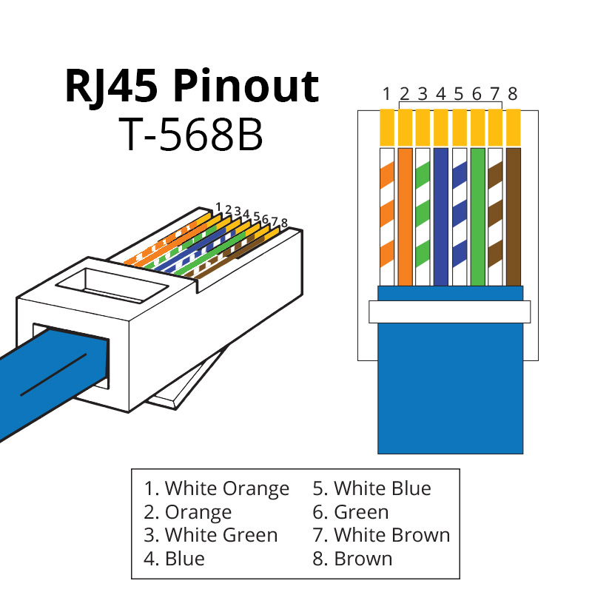
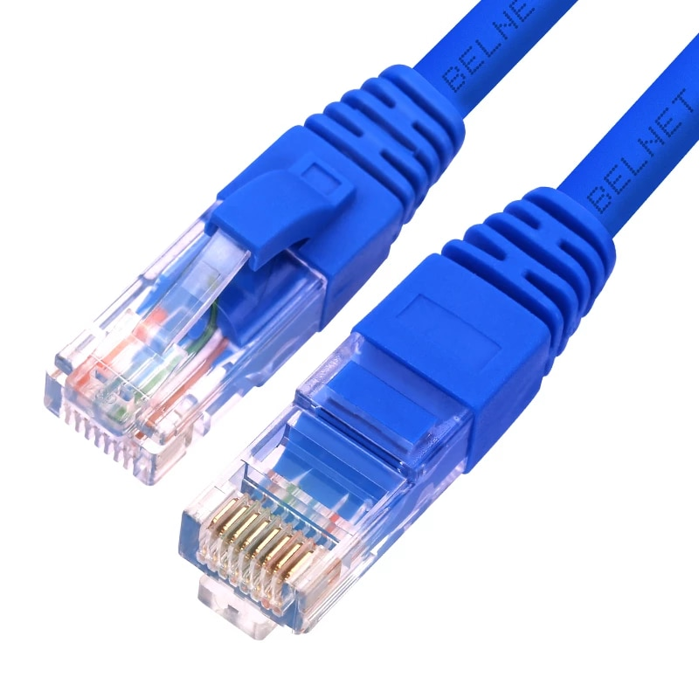
Crimping Network Cables
Crimping an ethernet cable is the process of attaching connectors onto the ends of ethernet cables. This process is also called 'RJ45 crimping' because RJ45 is the name of the connectors that are used for ethernet cables, and they are what is being crimped.

Slide 6
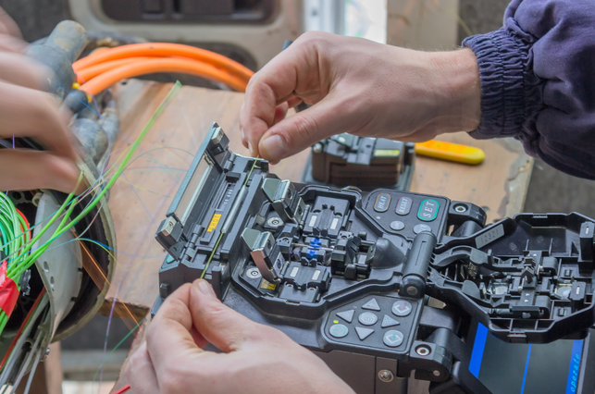
Fusion Splicing of Fiber Cable
Fusion splicing is the act of joining two optical fibers end-to-end. The goal is to fuse the two fibers together in such a way that light passing through the fibers is not scattered or reflected back by the splice, and so that the splice and the region surrounding it are almost as strong as the intact fiber. The source of heat used to melt and fuse the two glass fibers being spliced is usually an electric arc, but can also be a laser, a gas flame, or a tungsten filament through which current is passed.

Slide 7
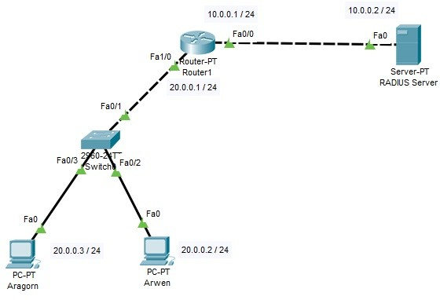
Cisco Packet Tracer
Cisco Packet Tracer is Cisco's simulation software. It can be used to create complicated network typologies, as well as to test and simulate abstract networking concepts. It acts as a playground for you to explore networking and the experience is very close to what you see in computer networks.

Slide 8
EXPERIENCE AND SKILLS ACQUIRED
The five weeks Industrial training I undertook at ITNH, ITeMS, U.I, helped me to be able to:
Connect the computer networks including mainframes, routers, servers and other physical hardware.
Fix a damaged Network Pattress.
Use the Cisco Packet Tracer simulation to distribute and create a network.
Crimp a RJ45 network cable.
Splice a fiber cable using fusion method.
Improve my interpersonal and communication skills.

Slide 9
CONCLUSION
The Students’ Industrial Work-Experience Scheme (SIWES) organized by the University of Ibadan has offered me the opportunity of interacting with industrial environment while still undergoing my academic training. The Industrial Training has not only boosted my initiative on value-added approach, there was an improvement on my quality-mindedness and problem solving skills. It has also enhanced my sense of responsibility and ability to work under less supervision.

Slide 10
RECOMMENDATION
ITCC should include in the SIWES placement letter to the organizations that students should be given stipends and some compensation for the period of their Industrial Training. This is to motivate and encourage students to do more better in their endeavors.

Slide 11


